Slide 2
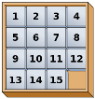
9.1 Fifteen-Game (Board Game)
Objectives
Count, read, and write whole numbers up to 20
Order and compare numbers up to 20
Recognize, describe, and extend patterns and determine a next term in linear patterns
Recognize and name two dimensional shapes
Describe length and width of shapes
Measure areas by counting squares

Slide 3
9.1 Fifteen-Game (Board Game)
Tools, Materials and Organisation
A sliding 15-puzzle consisting in a 4x4 square box and fifteen pieces numbered from 1 to 15.
A sheet of patterns that each student should try to solve.
The lesson takes two sessions of 45 minutes.

Slide 4
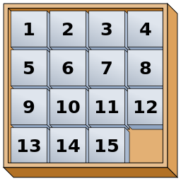
9.1 Fifteen-Game (Board Game)
Fifteen puzzle

Slide 5
9.1 Fifteen-Game (Board Game)
Description of the Lesson
First part of the lesson:
Arrange groups with 2 persons.
Give them an empty square box and fifteen numbered cubes.
Tell them to place the cubes in ascending and descending order out of the box.
Ask them to puts the cubes into the box in ascending and descending order in rows.
Ask them to put the cubes into the box in ascending and descending order in columns.

Slide 6
9.1 Fifteen-Game (Board Game)
Description of the Lesson
Second part of the lesson:
The teacher explains the game
One of the students is playing the game while the other one is watching.
One of the students (the observer) put the cubes in the box in random order.
The teacher gives them a sheet with 6 different patterns.
The other student (the player) has to place the pieces in order by making sliding moves that use the empty space.
The participants play several times the game changing roles (player and observer) trying to solve most of the patterns in the sheet.

Slide 7
9.1 Fifteen-Game (Board Game)
Useful Hints
Make sure the students can count well and order the numbers in ascending and descending order.
Make sure the students understand the concept of row and column.
Use the first part of the lesson to explain and clarify these items. They must understand the underlying concepts; otherwise they won’t be able to play the game.

Slide 8
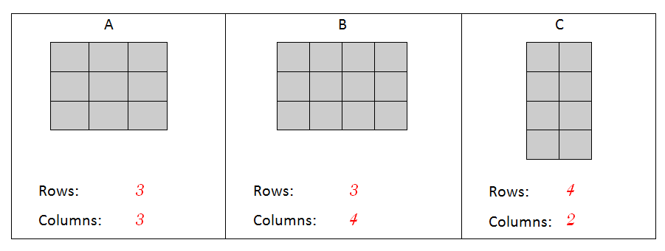
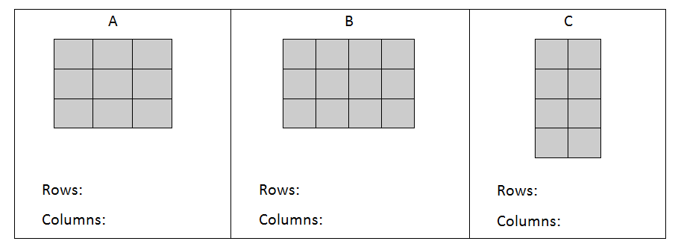
9.1 Fifteen-Game (Board Game)
ACTIVITIES I
How many rows are there in each figure? How many columns are there in each figure?

Slide 9
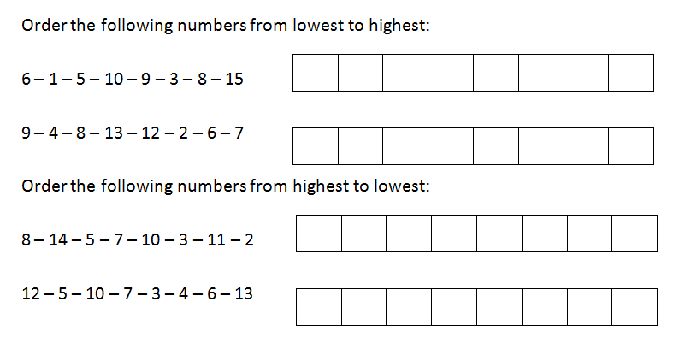
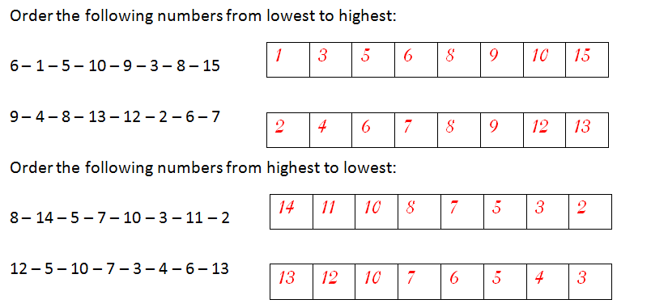
9.1 Fifteen-Game (Board Game)
ACTIVITIES II

Slide 10
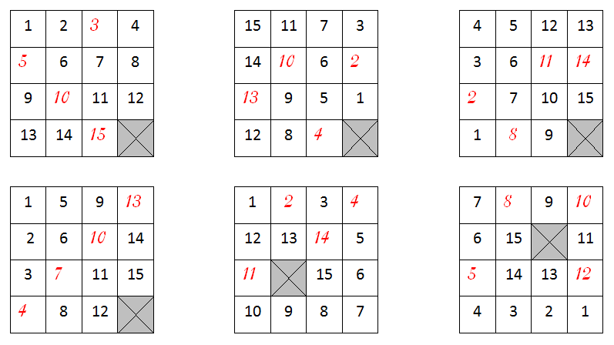
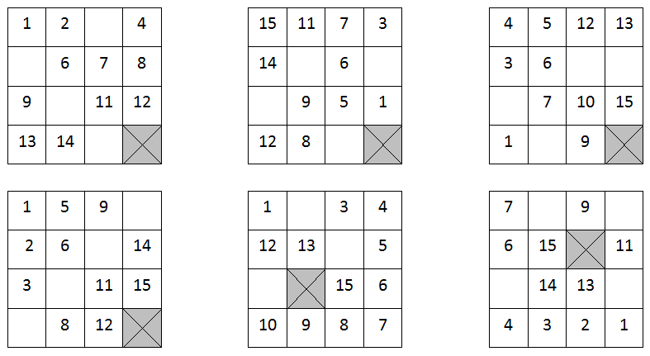
9.1 Fifteen-Game (Board Game)
ACTIVITIES III
Fill in the blanks at the tables with the suitable numbers to complete the sequences properly:

Slide 11
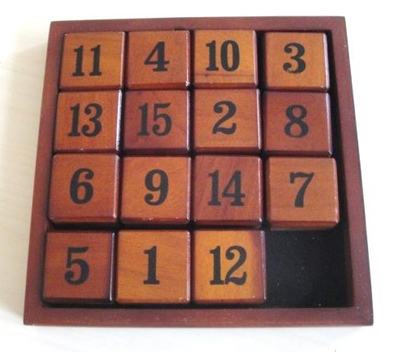
9.1 Fifteen-Game (Board Game)
LET’S PLAY THE GAME

Slide 12
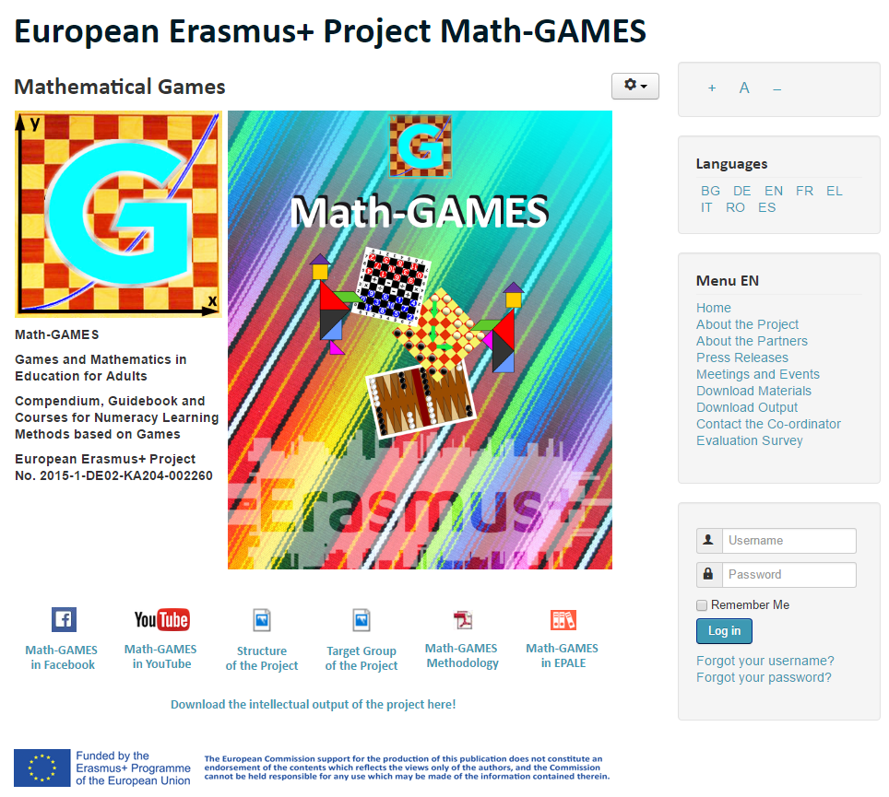
The result is: Play Games and learn Mathematics more easily.
Our Project-Website will help you: www.math-games.eu

